Slide 1
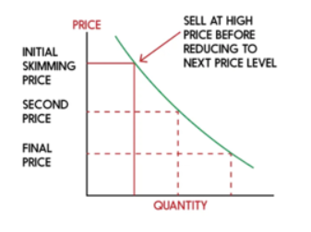



Apple’s Pricing Strategy
–Premium/Skimming Strategy
From Premium to Practical
Apple Slashes iPhone Prices in China

Slide 2



Apple’s Pricing Strategy in China
Aggressive Price Cuts on select iPhone models
Reasons for Discount Strategy
- Weak economy: Price-sensitive consumers
- Promotional Period: “618” shopping festival
- Local manufacturers: Huawei & Xiaomi
From Premium to Practical
Apple Slashes iPhone Prices in China
Apple’s Pricing Strategy – Premium/Skimming Strategy

